Slide 1
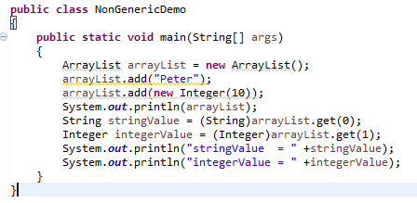
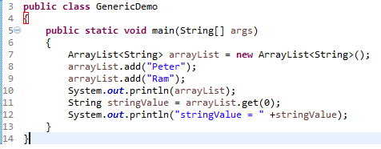
Generics in Java
Now generics, forces the java programmer to store specific type of objects.
Type-safety : We can hold only a single type of objects in generics. It doesn’t allow to store other objects.
Type casting is not required: There is no need to typecast the object.
Compile-Time Checking: It is checked at compile time so problem will not occur at runtime. The good programming strategy says it is far better to handle the problem at compile time than runtime.
The Java Generics programming is introduced in J2SE 5 to deal with type-safe objects.
Before generics, we can store any type of objects in collection i.e. non-generic.
Before Generics, we need to type cast.
Type casting

Slide 2
Generics in Java
Syntax to use generic collection
Class<Type>
or
Interface<Type>
Example to use Generics in java
ArrayList<String>
Set<Interger>

